Slide 1

Fitting Linear Models, Regularization & Cross Validation
?
Slides by:
Joseph E. Gonzalez jegonzal@cs.berkeley.edu
Fall’18 updates:
Fernando Perez fernando.perez@berkeley.edu

Slide 2
Previously

Slide 3
Feature Engineering and Linear Regression
Domain
Feature Engineering
Linear
Regression

Slide 4

Recap: Feature Engineering
Notation: Computer scientist / ML researchers tend to you d (dimensions) and statisticians will use p (parameters).
Linear models with feature functions:
Feature Functions:
p
Domain

Slide 5
One-hot encoding: Categorical Data
Bag-of-words & N-gram: Text Data
Custom Features: Domain Knowledge

Slide 6
The Feature Matrix
Domain
DataFrame
uid | age | state | hasBought | review
0 | 32 | NY | True | ”Meh.”
42 | 50 | WA | True | ”Worked out of the box …”
57 | 16 | CA | NULL | “Hella tots lit...”
AK | … | NY | … | WY | age | hasBought | hasBought missing
0 | … | 1 | … | 0 | 32 | 1 | 0
0 | … | 0 | … | 0 | 50 | 1 | 0
0 | … | 0 | … | 0 | 16 | 0 | 1
Entirely Quantitative Values

Slide 7
The Feature Matrix
Domain
DataFrame
uid | age | state | hasBought | review
0 | 32 | NY | True | ”Meh.”
42 | 50 | WA | True | ”Worked out of the box …”
57 | 16 | CA | NULL | “Hella tots lit...”
AK | … | NY | … | WY | age | hasBought | hasBought missing
0 | … | 1 | … | 0 | 32 | 1 | 0
0 | … | 0 | … | 0 | 50 | 1 | 0
0 | … | 0 | … | 0 | 16 | 0 | 1
Entirely Quantitative Values
Another quick note on confusing notation.
In many textbooks and even in the class notes and discussion you will see:
and
In this case we are assuming X is the transformed data 𝚽. This can be easier to read but hides the feature transformation process.
Capital Letter: Matrix or Random Variable?
Both tend to be capitalized
Unfortunately, there is no common convention … you will have to use context.

Slide 8
The Feature Matrix
AK | … | NY | … | WY | age | hasBought | hasBought missing
0 | … | 1 | … | 0 | 32 | 1 | 0
0 | … | 0 | … | 0 | 50 | 1 | 0
0 | … | 0 | … | 0 | 16 | 0 | 1
Domain
Entirely Quantitative Values
n
Rows of the 𝚽 matrix correspond to records (observations, individuals, …)
=
=
DataFrame
Columns of the 𝚽 matrix correspond to features (predictors, covariates, …)
d
Confusing notation!
uid | age | state | hasBought | review
0 | 32 | NY | True | ”Meh.”
42 | 50 | WA | True | ”Worked out of the box …”
57 | 16 | CA | NULL | “Hella tots lit...”

Slide 9
The Feature Matrix
AK | … | NY | … | WY | age | hasBought | hasBought missing
0 | … | 1 | … | 0 | 32 | 1 | 0
0 | … | 0 | … | 0 | 50 | 1 | 0
0 | … | 0 | … | 0 | 16 | 0 | 1
Domain
Entirely Quantitative Values
n
Rows of the 𝚽 matrix correspond to records.
=
=
DataFrame
Columns of the 𝚽 matrix correspond to features.
Notation Guide
d
: row i of matrix A.
: column j of matrix A.
uid | age | state | hasBought | review
0 | 32 | NY | True | ”Meh.”
42 | 50 | WA | True | ”Worked out of the box …”
57 | 16 | CA | NULL | “Hella tots lit...”

Slide 10
Making Predictions
AK | … | NY | … | WY | age | hasBought | hasBought missing
0 | … | 1 | … | 0 | 32 | 1 | 0
0 | … | 0 | … | 0 | 50 | 1 | 0
0 | … | 0 | … | 0 | 16 | 0 | 1
Entirely Quantitative Values
n
Domain
Rows of the 𝚽 matrix correspond to records.
=
=
DataFrame
Columns of the 𝚽 matrix correspond to features.
d
Prediction
n
=
=
d
uid | age | state | hasBought | review
0 | 32 | NY | True | ”Meh.”
42 | 50 | WA | True | ”Worked out of the box …”
57 | 16 | CA | NULL | “Hella tots lit...”

Slide 11
Normal Equations
Solution to the least squares model:
Given by the normal equation:
You should know this!
You do not need to know the calculus based derivation.
You should know the geometric derivation …

Slide 12
Geometric Derivation
Examine the column spaces:
Columns space of 𝚽
n
n
=
d
1

Slide 13
Geometric Derivation: Not Bonus Material
We decided that this is too exciting to not know.
Examine the column spaces:
n dimensional space
Y
Columns space of 𝚽
n
n
=
d dimensional subspace
d
1
Derivation
Definition of orthogonality
“Normal Equation”

Slide 14
The Normal Equation
n
d
n
1
-1
d
=
d
Note: For inverse to exist 𝚽 needs to be full column rank.
→ cannot have co-linear features
This can be addressed by adding regularization …
In practice we will use regression software (e.g., scikit-learn) to estimate θ

Slide 15
Least Squares Regression in Practice
Use optimized software packages
Address numerical issues with matrix inversion
Incorporate some form of regularization
Address issues of collinearity
Produce more robust models
We will be using scikit-learn:
http://scikit-learn.org/stable/modules/linear_model.html
See Homework 6 for details!

Slide 16
Scikit Learn Models
Scikit Learn has a wide range of models
Many of the models follow a common pattern:
from sklearn import linear_model
f = linear_model.LinearRegression(fit_intercept=True)
f.fit(train_data[['X']], train_data['Y'])
Yhat = f.predict(test_data[['X']])
Ordinary Least Squares Regression

Slide 17
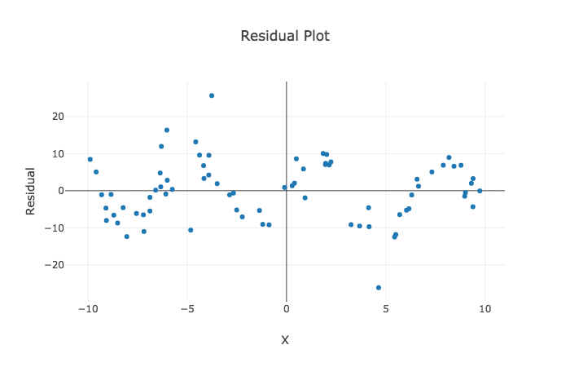
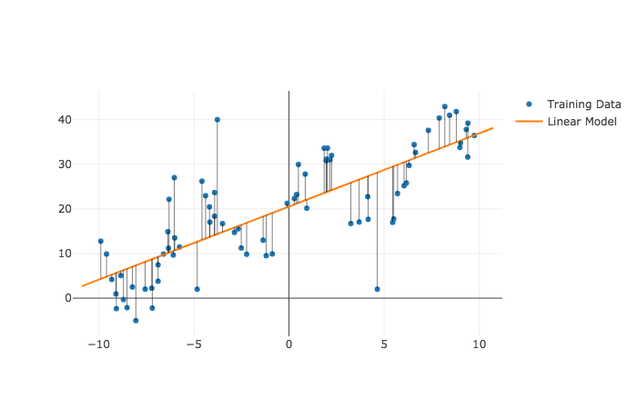
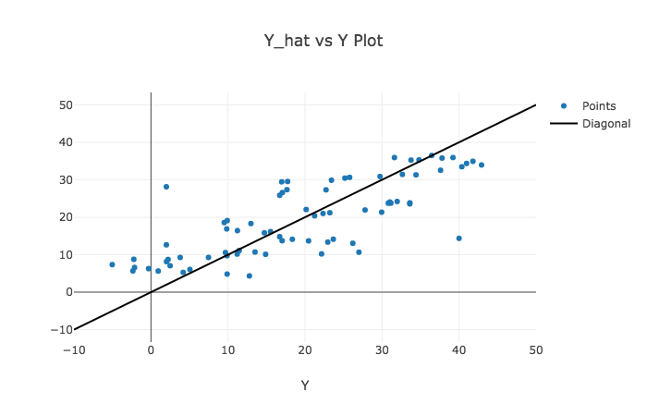
Diagnosing Fit → The Residuals
Dependence on each feature
Residuals
Predicted Y vs True Y
Look at Spread

Slide 18
Regularization Parametrically Controlling the Model Complexity
𝜆
Tradeoff:
Increase bias
Decrease variance

Slide 19
Basic Idea of Regularization
Penalize
Complex Models
Fit the Data
Regularization Parameter
How should we define R(θ)?
How do we determine 𝜆?

Slide 20
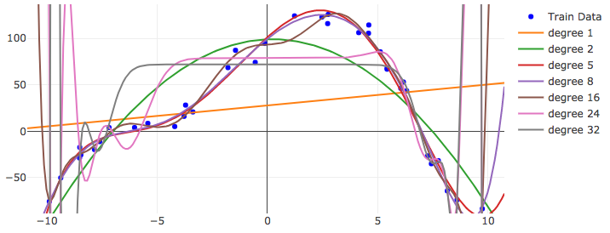
The Regularization Function R(θ)
Goal: Penalize model complexity
Recall earlier:
More features → overfitting …
How can we control overfitting through θ
Proposal: set weights = 0 to remove features
Notes:
Notes:
- Any regularization is a type of bias: It tells us how to select a model among others, absent additional evidence from the data.
- Regularization terms are independent of the data. Therefore it reduces the variance of the model.

Slide 21
Common Regularization Functions
Ridge Regression (L2-Reg)
LASSO
(L1-Reg)
Distributes weight across related features (robust)
Analytic solution (easy to compute)
Does not encourage sparsity → small but non-zero weights.
Encourages sparsity by setting weights = 0
Used to select informative features
Does not have an analytic solution → numerical methods
Notes:
Least Absolute Shrinkage and Selection Operator

Slide 22
Python Demo!
The shapes of the norm balls.
Maybe show reg. effects on actual models.

Slide 23
An alternate (dual) view on regularization
A little easier for geometrical intuition

Slide 24
Basic Idea
Such that:
is not too “complicated”
Can we make this more formal?

Slide 25
Basic Idea
Regularization Parameter
Such that:
Complexity( )
How do we define this?

Slide 26
Idealized Notion of Complexity
Complexity( )
Focus on complexity of linear models:
Number and kinds of features
Ideal definition:
Why?
Number of non-zero parameters

Slide 27
Ideal “Regularization”
Find the best value of θ which uses fewer than β features.
Such that:
Need an approximation!
Combinatorial search problem
→ NP-hard to solve in general.

Slide 28
Norm Balls
L⁰ Norm Ball

Slide 29
Norm Balls
Non-convex → Hard to solve constrained optimization problem
L⁰ Norm Ball

Slide 30
Norm Balls
L⁰ Norm Ball
Can we construct a convex approximation?

Slide 31
Norm Balls
Convex approximation!
L¹ Norm Ball

Slide 32
Norm Balls
Convex approximation!
L¹ Norm Ball

Slide 33
Norm Balls
Convex approximation!
L¹ Norm Ball

Slide 34
Norm Balls
Convex approximation!
L¹ Norm Ball

Slide 35
Norm Balls
Other Approximations?
L¹ Norm Ball

Slide 36
Norm Balls
L² Norm Ball

Slide 37
Norm Balls
L² Norm Ball

Slide 38
Norm Balls
L² Norm Ball

Slide 39
Norm Balls
L² Norm Ball

Slide 40
L⁰ Norm Ball
L¹ Norm Ball
L² Norm Ball
L¹ + L² Norm
^{Elastic Net}
Ideal for Feature Selection but combinatorically difficult to optimize
Encourages Sparse Solutions
Convex!
Spreads weight over features (robust)
does not encourage sparsity
Compromise
Need to tune two regularization parameters

Slide 41
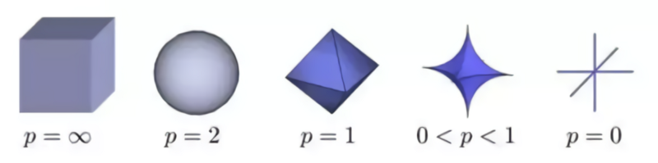
The Lp norms

Slide 42
Generic Regularization (Constrained)
Defining
There is an equivalent unconstrained formulation (obtained by Lagrangian duality)
Such that:

Slide 43
Generic Regularization (Constrained)
Defining
There is an equivalent unconstrained formulation (obtained by Lagrangian duality)
Regularization Parameter

Slide 44
Determining the Optimal 𝜆
Test Error
Optimal Value
Validation Error
(Bias)²
Error
How do we determine 𝜆?
Variance
Increasing 𝜆
Value of 𝜆 determines bias-variance tradeoff
Larger values → more regularization → more bias → less variance
Determined through cross validation

Slide 45
Using Scikit-Learn for Regularized Regression
import sklearn.linear_model
Regularization parameter 𝛼 = 1/λ
larger 𝛼 ➔ less regularization → greater complexity → overfitting
Lasso Regression (L1)
linear_model.Lasso(alpha=3.0)
linear_model.LassoCV() automatically picks 𝛼 by cross-validation
Ridge Regression (L2)
linear_model.Ridge(alpha=3.0)
linear_model.RidgeCV() automatically selects 𝛼 by cross-validation
Elastic Net (L1 + L2)
linear_model.ElasticNet(alpha=3.0, l1_ratio = 2.0)
linear_model.ElasticNetCV() automatically picks 𝛼 by cross-validation

Slide 46
http://bit.ly/ds100-fa18-opq

Slide 47
Notebook Demo

Slide 48
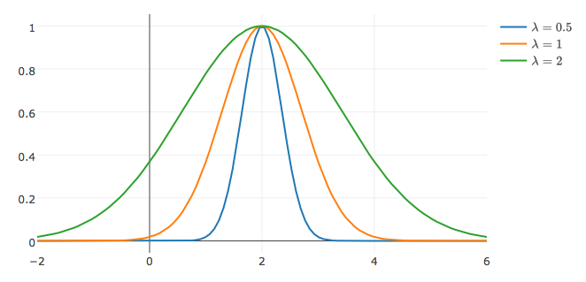
Generic Features: increase model expressivity
Gaussian Radial Basis Functions:
Gaussian RBF

Slide 49
Training Error
Impressive!

Slide 50
Training vs Test Error
Failure to Generalize!
Impressively
Bad! ☹

Slide 51
Training vs Test Error
Training error typically under estimates test error.
← Underfitting
Overfitting →
Best Fit
Test Error
Error
Training Error
Model “complexity”
(e.g., number of features)

Slide 52
Generalization: The Train-Test Split
Training Data: used to fit model
Test Data: check generalization error
How to split?
Randomly, Temporally, Geo…
Depends on application (usually randomly)
What size? (90%-10%)
Larger training set → more complex models
Larger test set → better estimate of generalization error
Typically between 75%-25% and 90%-10%
Train - Test
Split
Train
Data
Test
You can only use the test dataset once after deciding on the model.

Slide 53
Generalization: Validation Split
Training Data: used to fit model
Test Data: check generalization error
How to split?
Randomly, Temporally, Geo…
Depends on application (usually randomly)
What size? (90%-10%)
Larger training set → more complex models
Larger test set → better estimate of generalization error
Typically between 75%-25% and 90%-10%
V
Train - Test
Split
Validation
Split
Train
Train
V
Train
Train
V
Train
Data
V
Train
Validate Generalization
V
5-Fold
Cross Validation
Test
Cross validation simulates multiple train test-splits on the training data.
You can only use the test dataset once after deciding on the model.

Slide 54
Recipe for Successful Generalization
Split your data into training and test sets (90%, 10%)
Use only the training data when designing, training, and tuning the model
Use cross validation to test generalization during this phase
Do not look at the test data
Commit to your final model and train once more using only the training data.
Test the final model using the test data. If accuracy is not acceptable return to (2). (Get more test data if possible.)
Train on all available data and ship it!

Slide 55
Standardization and the Intercept Term
Height = θ₁ age_in_seconds + θ₂ weight_in_tons
Regularization penalized dimensions equally
Standardization
Ensure that each dimensions has the same scale
centered around zero
Intercept Terms
Typically don’t regularize intercept term
Center y values (e.g., subtract mean)
Small
Large
Standardization
For each dimension k:

